Slide 1

GraphRAG Neo4j Chatbot for London Transport Information
Intructors: Dr.Do Ba Lam
Student: Nguyen Ngoc Tu - 20251189M
Vu Tuan Kiet - 20242434M

Slide 2
Menu
Introduction
Related work
Methodology
Conclusion and future work

Slide 3
Introduction

Slide 4
Background & Motivation
Urban Transportation Data Challenges
Highly interconnected data: network topology, schedules, incidents, accessibility
Traditional relational DBs → data silos & inefficient retrieval
Solution
Knowledge Graphs + Semantic Web → better modeling & flexible queries
GraphRAG: Combines Knowledge Graph structure with LLM natural language capabilities
→ Enables natural language queries over complex graph data

Slide 5
Objectives, Scope & Limitations
Objectives
Analyze graph data modeling & semantic alignment
Evaluate NL query translation accuracy
Assess error handling & robustness
Identify strengths, limitations, improvements
Scope
London transport network
Tech stack: TfL API + Neo4j + GPT-4
No real-time execution (cost constraint)
Single-city focus (no multi-city support)

Slide 6
Related work

Slide 7
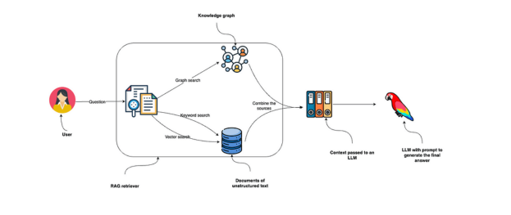
Graph Retrieval-Augmented Generation (GraphRAG)
GraphRAG is a structured, hierarchical approach to Retrieval Augmented Generation (RAG), as opposed to naive semantic-search approaches using plain text snippets. The GraphRAG process involves extracting a knowledge graph out of raw text, building a community hierarchy, generating summaries for these communities, and then leveraging these structures when perform RAG-based tasks.

Slide 8
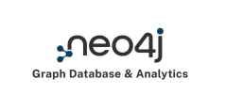
Neo4j Knowledge Graph
A knowledge graph is a design pattern for storing, organizing, and accessing interrelated data entities, including their semantic relationships. With knowledge graphs, you can better understand your data and build more intelligent applications.
Neo4j is a graph database that support to store data as nodes, relationships (edges), and their properties. Unlike traditional relational databases, Neo4j is designed to handle highly connected data efficiently, making it ideal for use cases like social networks, recommendation systems, fraud detection, and more.

Slide 9
Methodology

Slide 10
Architecture overview
Data integration
TfL API client with rate limiting and error handling
JSON-to-graph transformation modules
Batch processing capabilities for large datasets
2. Knowledge Graph Storage
Neo4j graph database with property graph model
Schema constraints and indexing strategies
Transaction management for data consistency
3. Query Interface Layer
Natural language processing via GPT-4 API
Cypher query generation and validation
Result formatting and presentation

Slide 11
Graph Data Model

Slide 12
Conclusion

Slide 13
THANK YOU !

